Slide 1
Human Capital Analytics
Webster University
CSDA 6010 – Project 1
Subash Yadav

Slide 2
Business Goal
Why Employees Are Leaving ? Key-Factors?
Analyze key factors like job satisfaction, salary, promotion history., Working Hours
Develop targeted retention strategies.
Primary Goal 2: Proactively Retain At-Risk Employees
Predicting Turnover Risk:
Implementing Retention Strategies:

Slide 3
Analytical Goal
Primary Analytical Goal: Leverage statistical analysis and machine learning to identify key turnover drivers and predict which employees are at the highest risk of leaving.
Clustering and Segmentation : Segment employees based on shared characteristics (e.g., satisfaction levels, tenure, performance) using clustering methods to tailor retention strategies.
Specific Analytical Objectives:
Exploratory Data Analysis (EDA): Understand patterns, distributions, and relationships in the dataset.
Hypothesis Testing: Validate assumptions regarding the key factors influencing employee turnover.
Predictive Modeling: Develop classification models to predict employee turnover.
Model Validation: Ensure models are robust, reliable, and generalizable.

Slide 4
Data Overview
Variable | Description | Type
satisfaction_level | Employee's job satisfaction level (0 to 1 scale) | Numerical
last_evaluation | Score of the employee’s most recent performance evaluation (0 to 1 scale) | Numerical
number_project | Total number of projects the employee has worked on | Numerical
average_montly_hours | Average number of hours worked per month | Numerical
time_spent_company | Number of years the employee has been with the company | Numerical
work_accident | Binary indicator if the employee experienced a work accident (1 = Yes, 0 = No) | Binary
left | Binary indicator if the employee has left the company (1 = Yes, 0 = No) | Binary
promotion_last_5years | Binary indicator if the employee was promoted in the last 5 years (1 = Yes, 0 = No) | Binary
department | Department the employee works in (e.g., sales, technical, HR) | Categorical
salary | Employee's salary level (low, medium, high) | Categorical
Total – 14999 Employees
Key Variables:
Satisfaction Level
Last Evaluation
Number of Projects
Average Monthly Hours
Time Spent at Company
Promotion in Last 5 Years
Salary
Sales

Slide 5
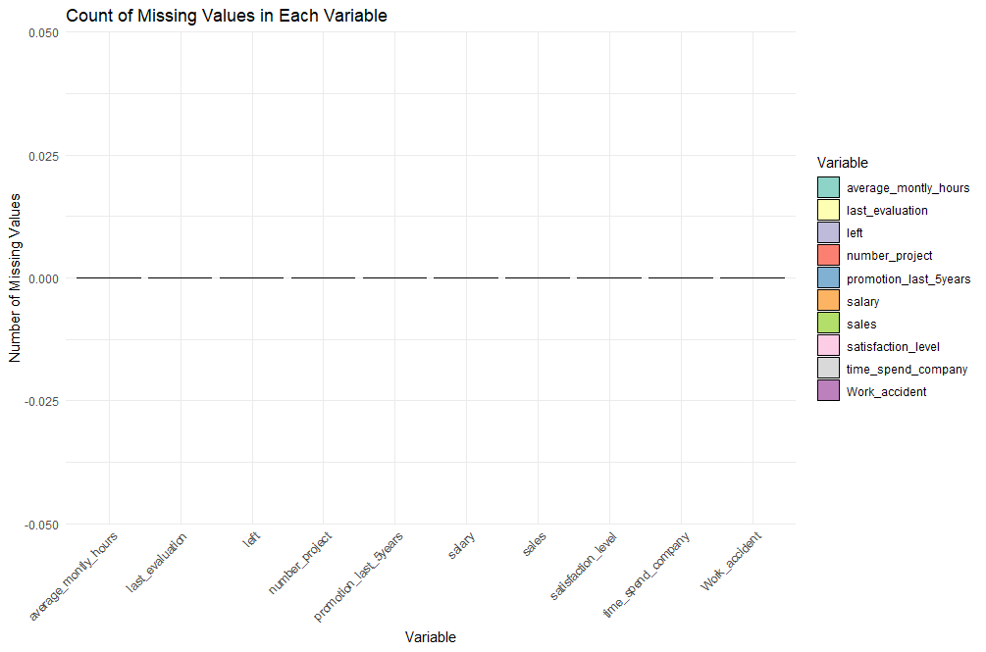
EDA
Data Completeness
All bars have a height of zero, indicating that there are no missing values in any variable.

Slide 6
EDA
Summary Statistics
 | Satisfaction_leve | Last_evaluation | Number_of_project | Average_Monthly_Hours | Time_Spend_in_Company
Min. | 0.900 | 0.3600 | 2.00 | 96.0 | 2.00
1st Qu. | 0.4400 | 0.5600 | 3.00 | 156.0 | 3.00
Median | 0.6400 | 0.7200 | 4.00 | 200. | 3.00
Mean | 0.6128 | 0.7161 | 3.803 | 201.1 | 3.498
3rd Qu. | 0.8200 | 0.8700 | 5.00 | 245.0 | 4.00
Max. | 1.00 | 1.00 | 7.00 | 310.0 | 10.00
Work Accident Rate:
Mean: 0.1446 (14.46%)
About 14.46% of employees have experienced a work-related accident. This could lead to dissatisfaction, especially if employees feel unsafe or unsupported after an accident.
Left:
Mean: 0.238 (23.8%)
Sales and Salary:
Sales (Departments): The company is divided into 10 departments
Salary Levels: There are three categories — "low," "medium," and "high,"

Slide 7
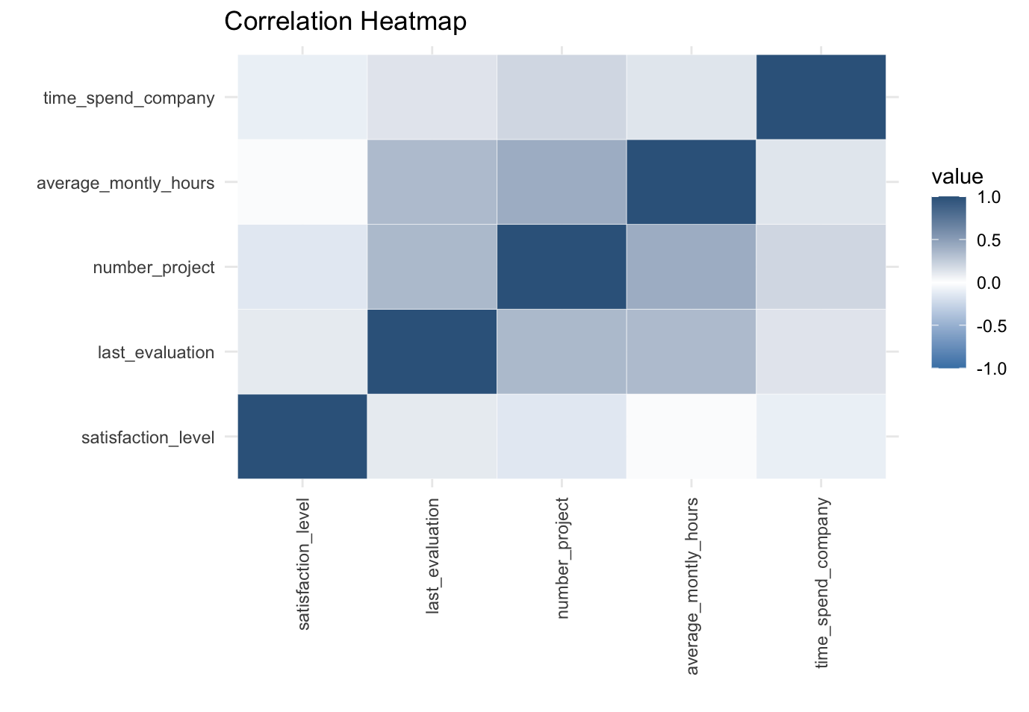
EDA
Correlation
Variable | Satisfaction Level | Last Evaluation | Number of Projects | Average Monthly Hours | Time Spent at Company
Satisfaction Level | 1.00 | 0.11 | -0.14 | -0.02 | -0.10
Last Evaluation | 0.11 | 1.00 | 0.35 | 0.34 | 0.13
Number of Projects | -0.14 | 0.35 | 1.00 | 0.42 | 0.20
Average Monthly Hours | -0.02 | 0.34 | 0.42 | 1.00 | 0.13
Time Spent at Company | -0.10 | 0.13 | 0.20 | 0.13 | 1.00

Slide 8
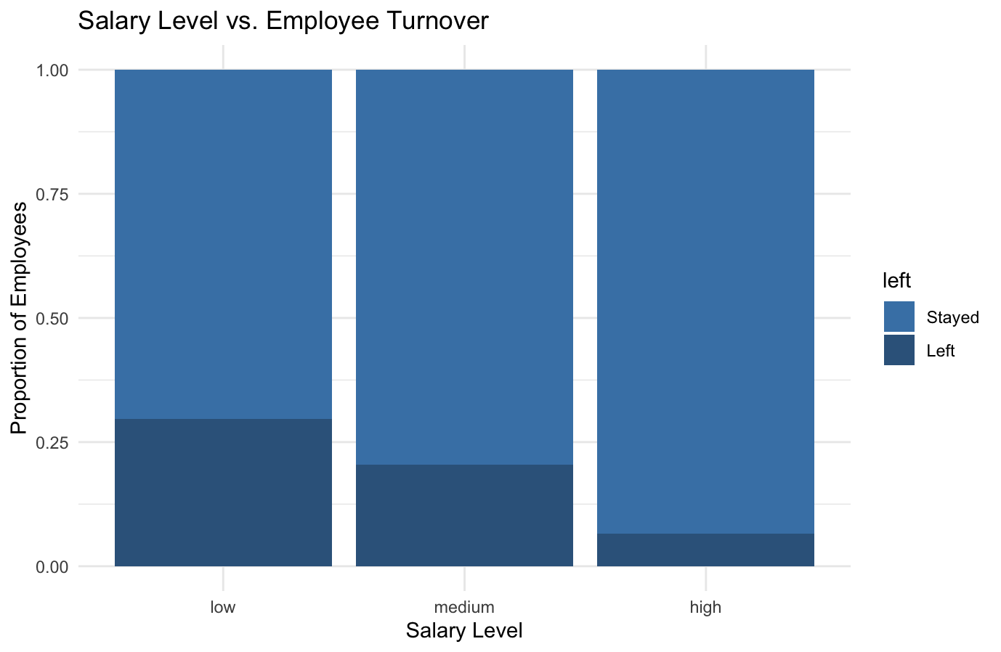
EDA (Hypothesis)
Hypothesis 1: Salary Is the Reason Why Employees Left the Company
Chi-Square Test Results:
Chi-Square Statistic (X-squared): 381.23
Degrees of Freedom (df): 2
p-value: < 2.2e-16

Slide 9
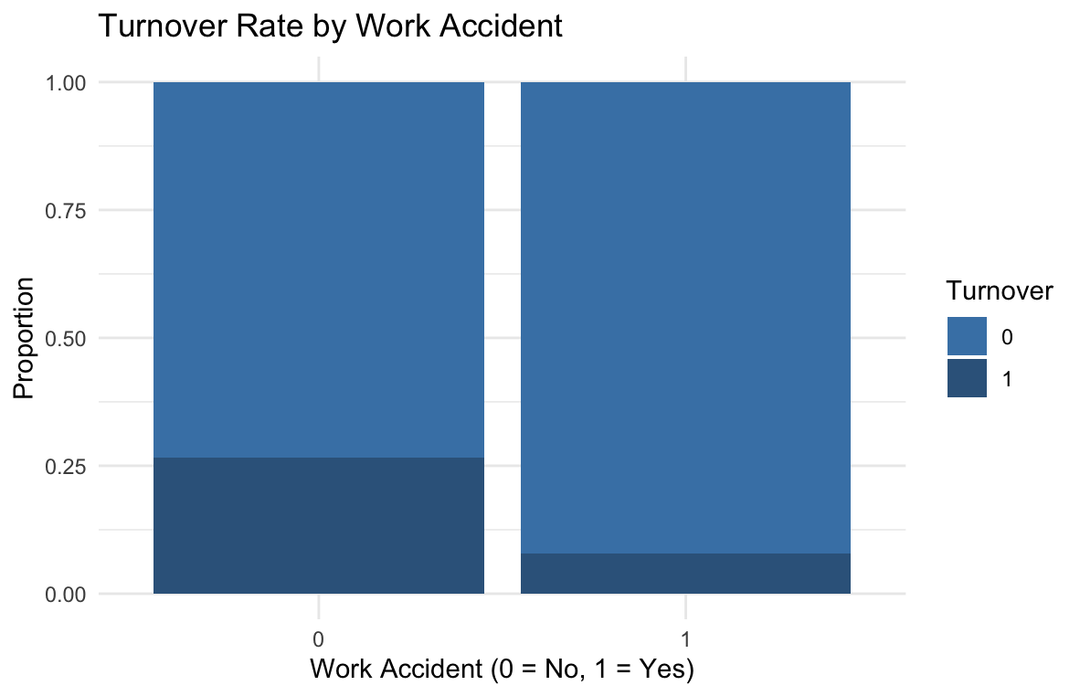
EDA (Hypothesis)
Hypothesis 2: Employees Leave the Company Because Work Is Not Safe
Work accident | Total_Employees | Employee_Left | Employee_Stayed | Proportion_Left
0 | 12830 | 3402 | 9428 | 0.265
1 | 2169 | 169 | 2000 | 0.0779

Slide 10
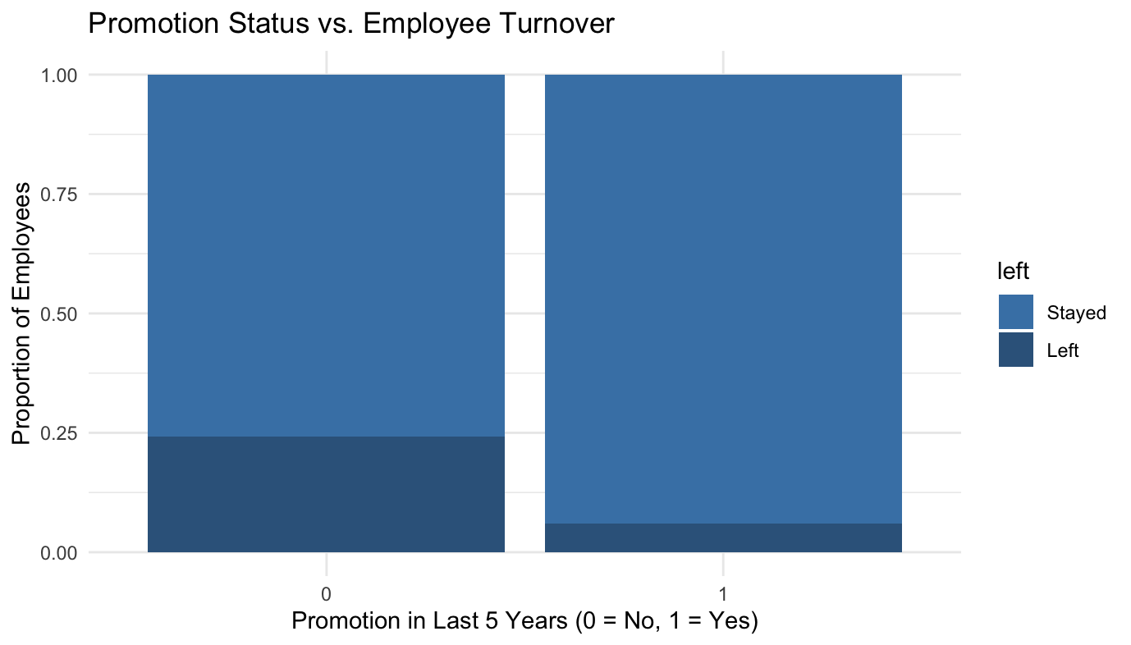
EDA (Hypothesis)
Hypothesis 3: this company is a good place to grow professionally.
Promotion_last_5years | Total Employees | Employee_Left | Employee_Stayed | Proportion_Left
0 | 14680 | 3552 | 11128 | 0.242
1 | 319 | 19 | 300 | 0.0596

Slide 11
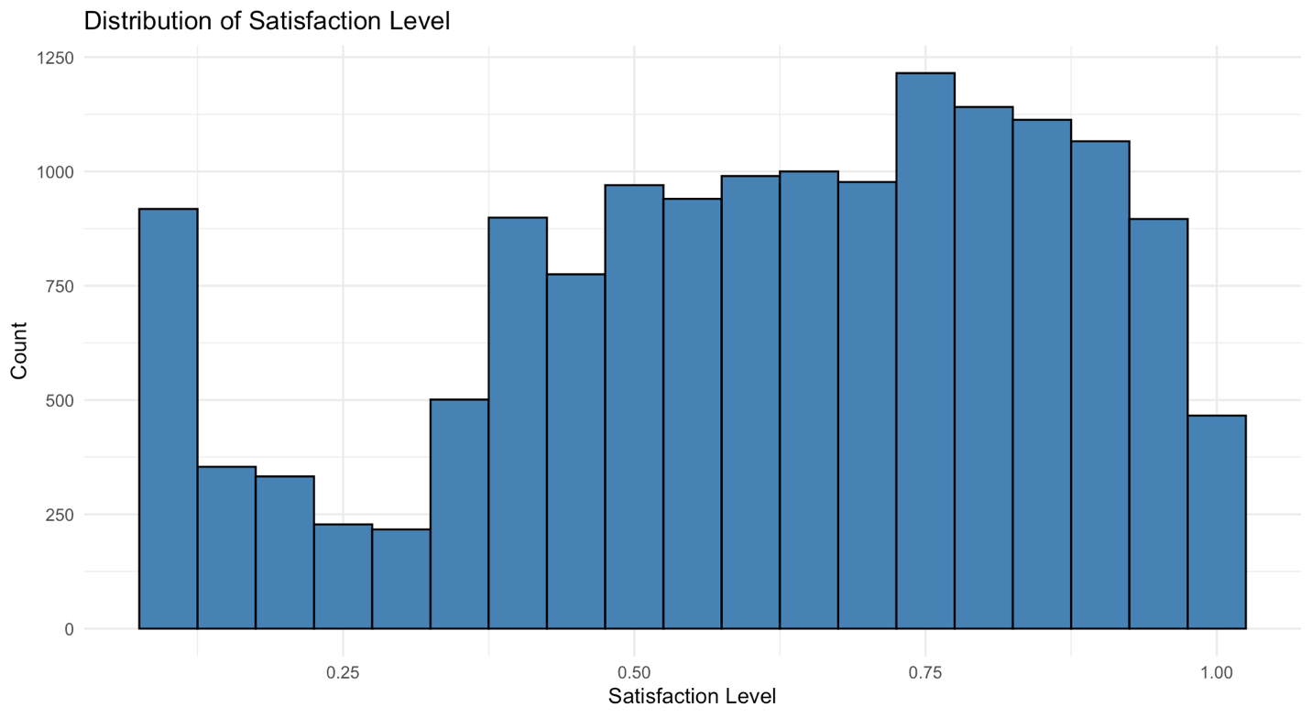
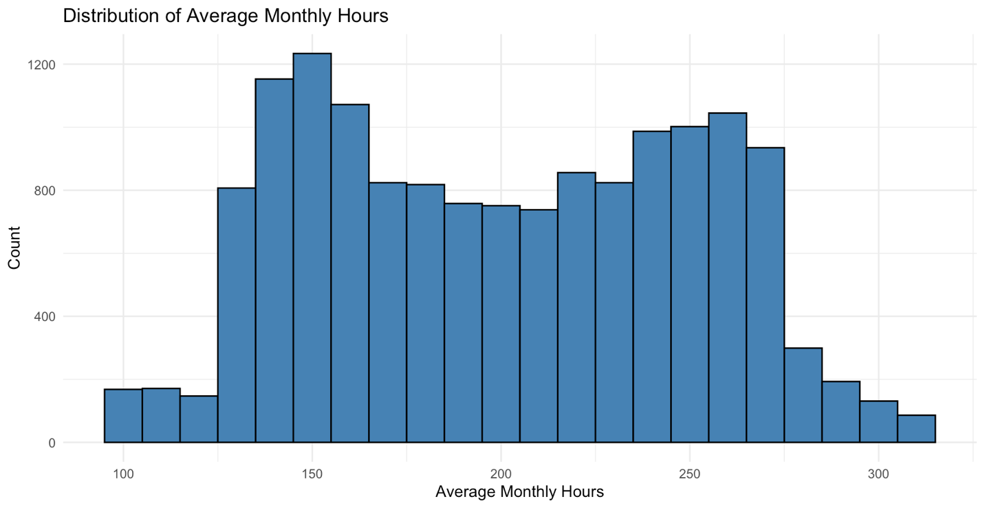
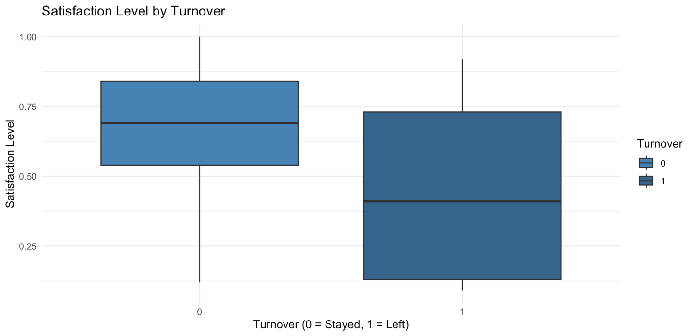
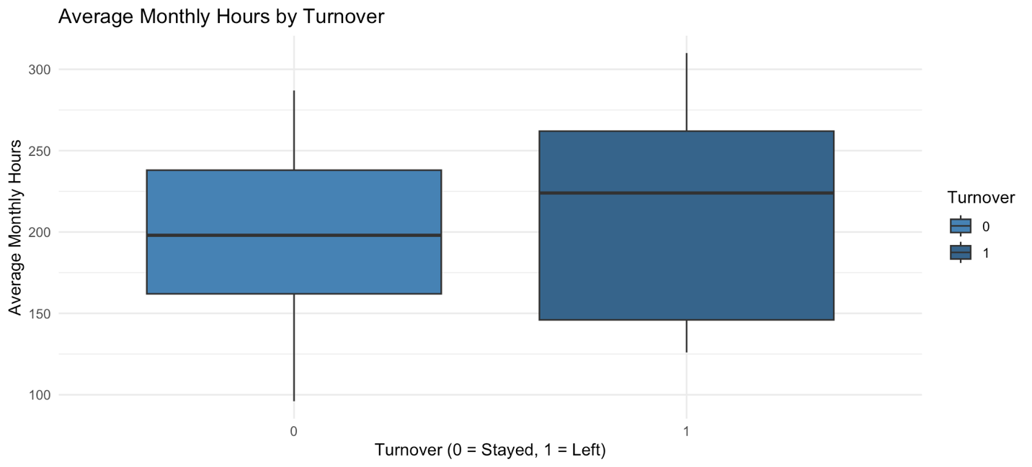
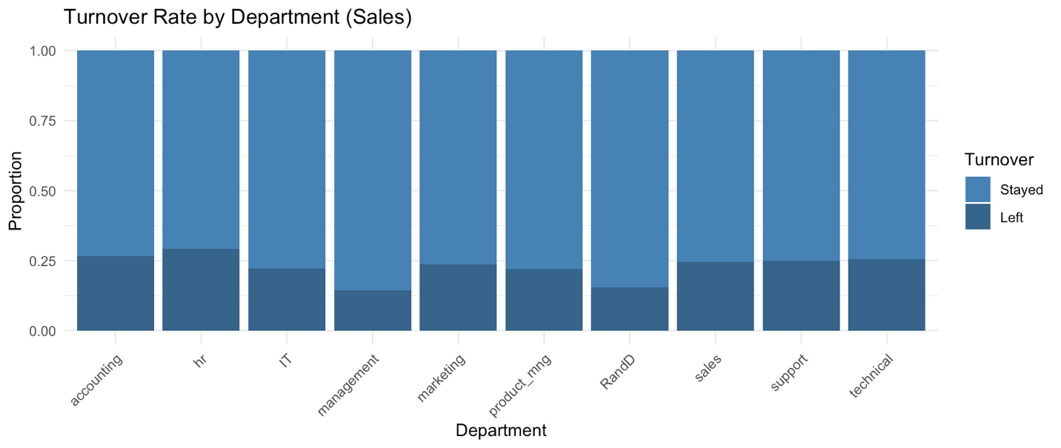
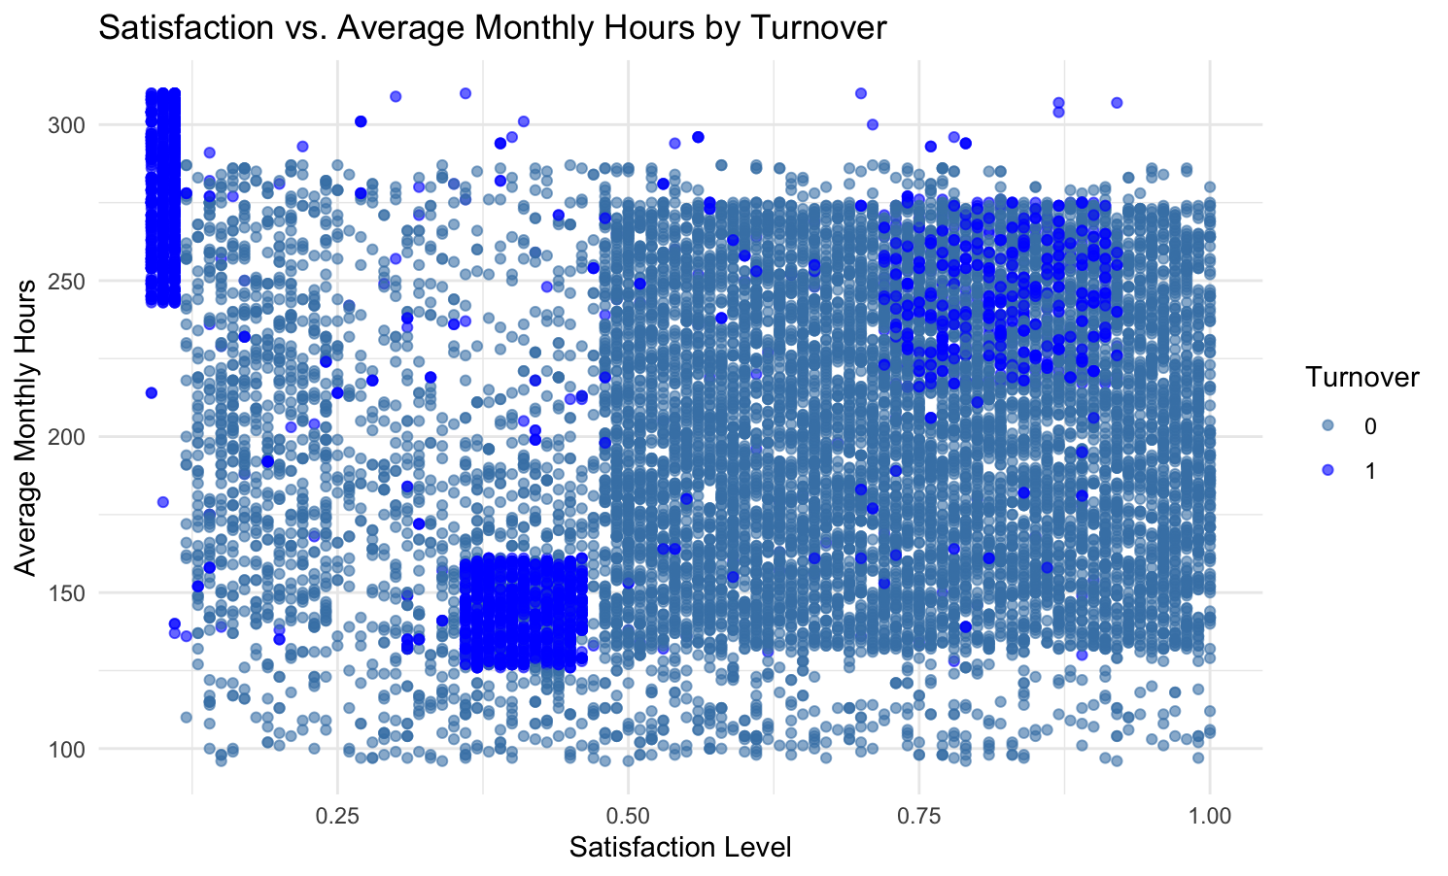
EDA

Slide 12
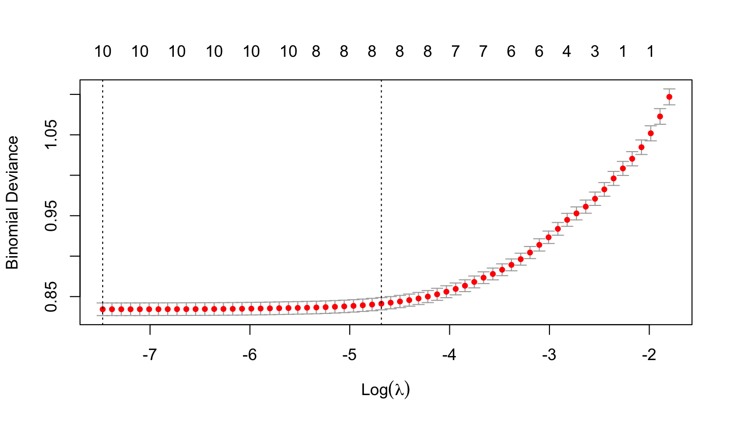
LASSO
Feature | Coefficient
Intercept | 1.989884
Satisfaction Level | -2.140467
Last Evaluation | 0 (eliminated)
Number of Projects | -0.257999
Time Spent at Company | 0.250880
Work Accident | -1.511600
Promotion in Last 5 Years | -1.408971
Sales | 0.009575
Salary | -0.691590
Hours Category (Low) | -0.174644
Hours Category (Moderate) | -1.110976
Satisfaction-Performance Score | -2.694608

Slide 13

Data Partition
70% Training Data: Used for building and training the model.
30% Testing Data: Reserved for evaluating the model's performance.

Slide 14
Classification Models
Metric | Logistic Regression | Decision Tree | Random Forest
Accuracy | 80.82% | 96.33% | 97.71%
Sensitivity | 92.88% | 98.51% | 99.45%
Specificity | 42.20% | 89.36% | 92.16%

Slide 15
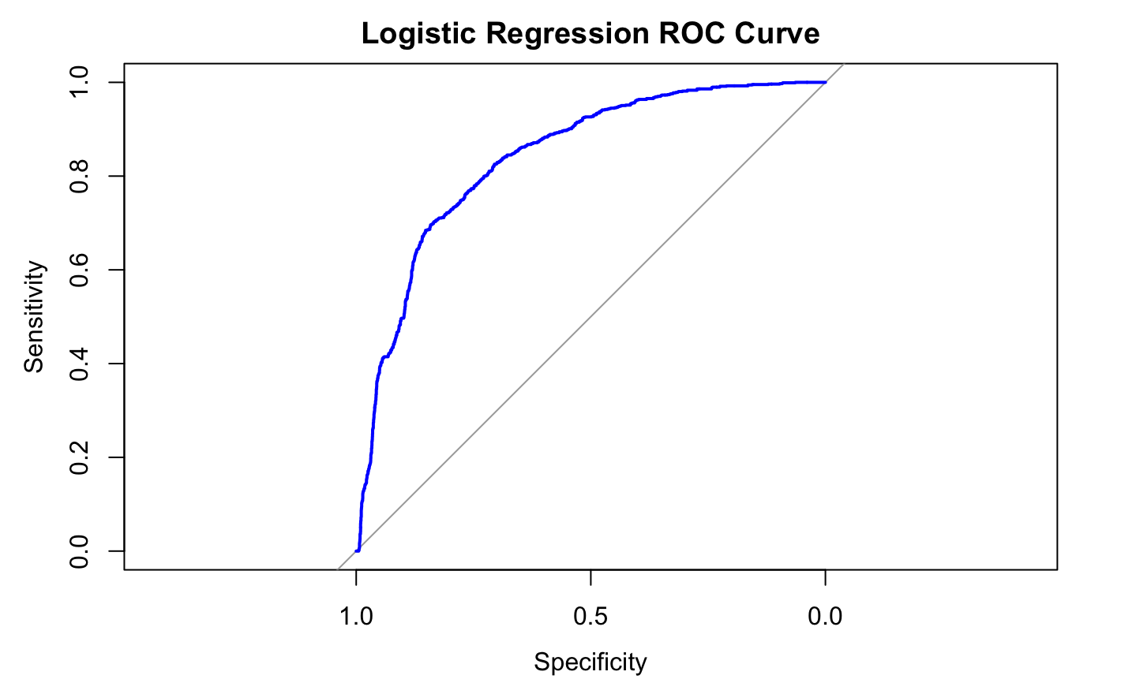
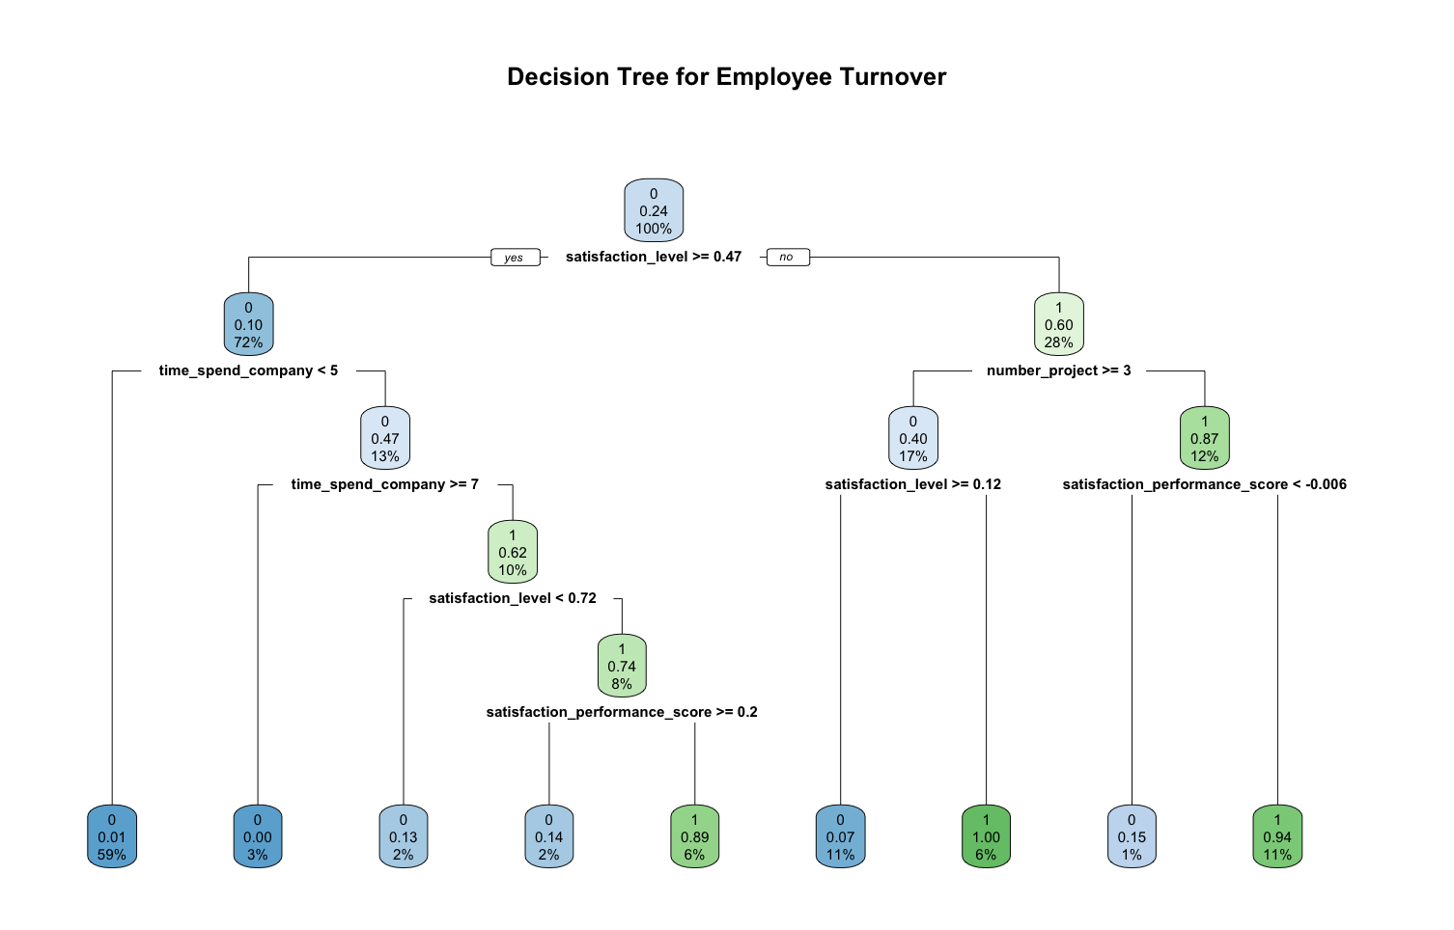
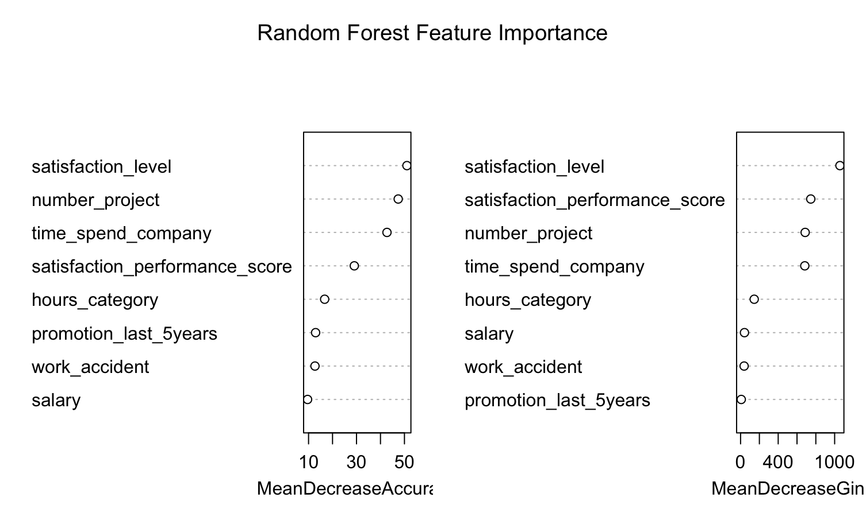
Classification Model

Slide 16
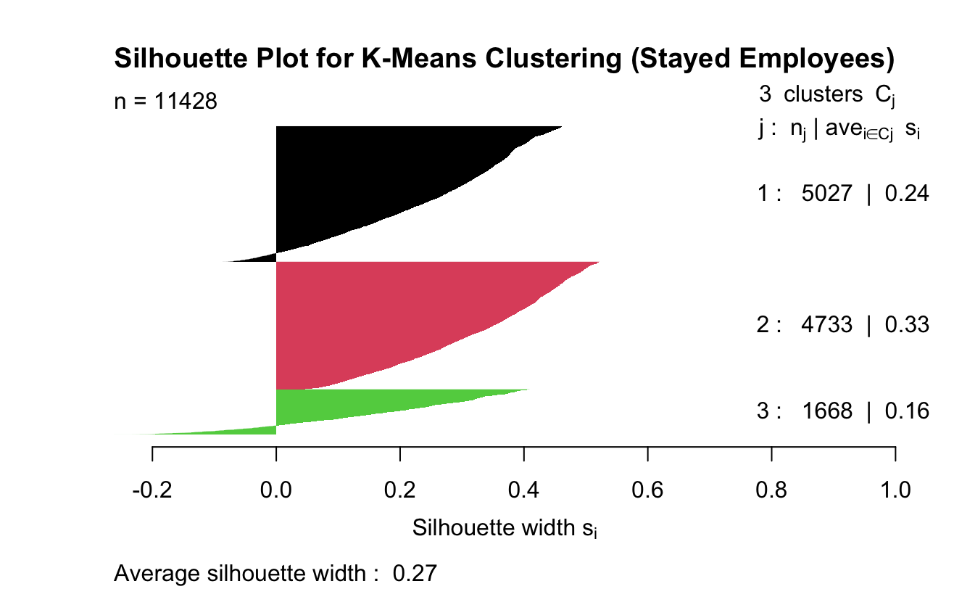
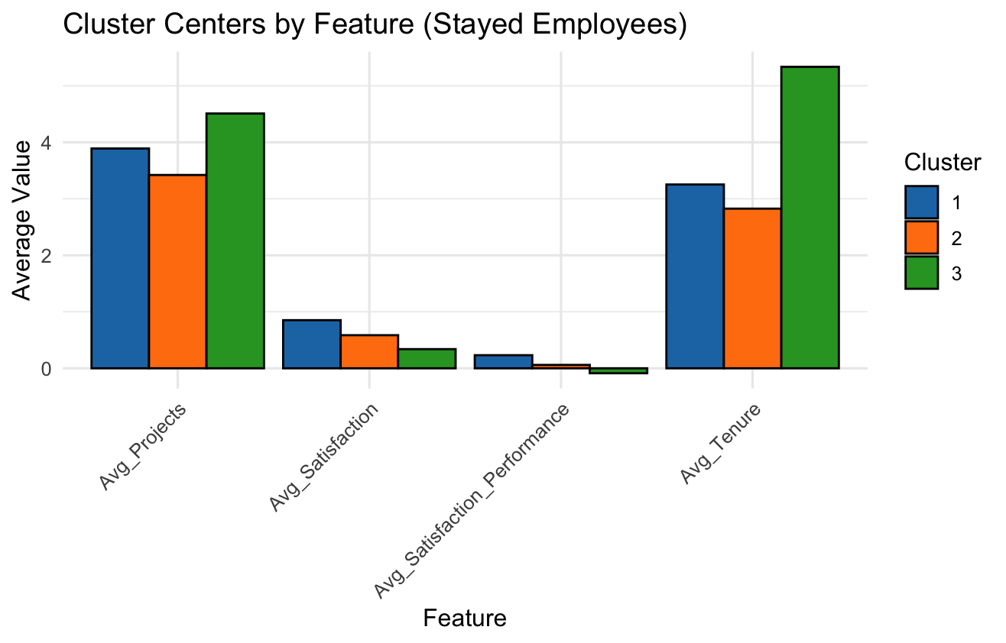
Clustering

Slide 17
Conclusion & Recommendations
Employee Turnover Drivers:
Job Satisfaction
Tenure, Workload and Project Involvement
Promotion and Compensation
Satisfaction-to-Performance Balance
For Cluster 3 (High Risk Employees):
Address Dissatisfaction:
Recognition and Career Growth:
For Cluster 2 (Medium Risk Employees):
Boost Engagement:
Preemptive Measures:
For Cluster 1 (Engaged Employees):
Maintain Satisfaction:
Encourage Advocacy:

Slide 18
Thank You
Questions?

